Slide 1


Movie Ticket Booking System
FINISH

Slide 2







Group Members
SOMANADH
VIGNESH
PAVAN SUJITH
ASHISH
KARTHIKEYA

Slide 3
Abstract
Web-based ticket booking platform using custom frontend and React components.
Offers real-time seat selection and secure payments.
Admin dashboard for managing theaters, shows, and pricing.
Designed for scalability and high user traffic.
Streamline the movie booking process online.
Enable users to browse movies, book seats, and make payments.
Admins manage schedules, pricing, and theater content.
Scalable for deployment in multiple locations.

Slide 4
FRONTEND AND BACKEND
Static structure: HTML + CSS
Dynamic interactivity with JavaScript and React.js
Routing via React Router DOM
State management with React Hooks (useState, useEffect)
1
API development with TypeScript and Express.js
MongoDB via Mongoose for schema-based data handling
Middleware for auth and validation
Well-structured codebase for scalability and maintainability
2

Slide 5
Goals
1
The primary goal of the Movie Ticket Booking System project was to develop an intuitive, efficient, and secure web-based platform that simplifies the process of booking movie tickets online. The project aimed to provide users with real-time seat selection, seamless navigation, and secure payment options through a responsive frontend built with HTML, CSS, JavaScript, and React.js.

Slide 6
INTERFACES AND CONSTRAINTS
Responsive web UI for users and admins.
Razorpay and PayPal APIs for payments.
SendGrid for notifications (email/SMS).
Stable internet connection required.
Third-party services must be operational.
Accurate theater data is mandatory.
Compliance with data protection laws (GDPR, PCI-DSS).

Slide 7
Result
The project resulted in a fully functional web application for seamless movie ticket booking. It features real-time seat selection, secure payments, and instant booking confirmations via QR code. An admin dashboard was implemented for managing movies, showtimes. The system is scalable, user-friendly, and capable of handling high traffic without performance issues

Slide 8
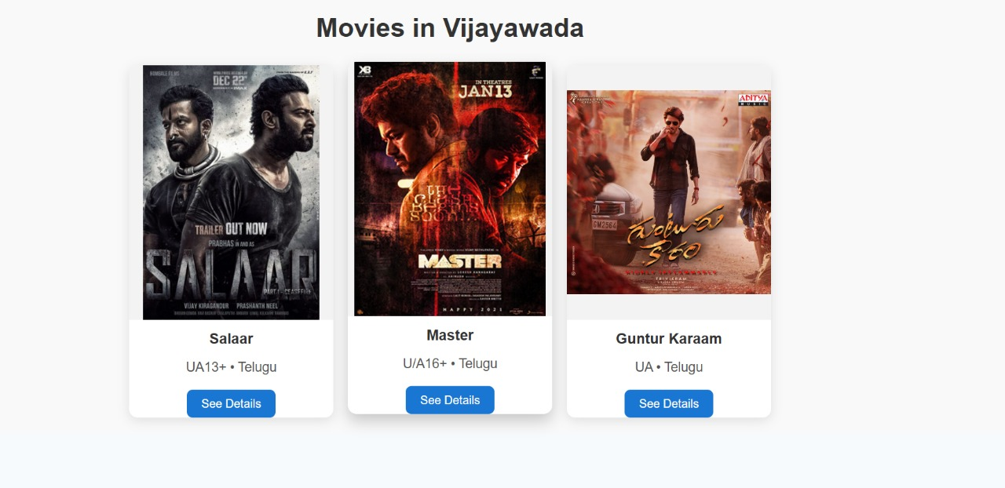
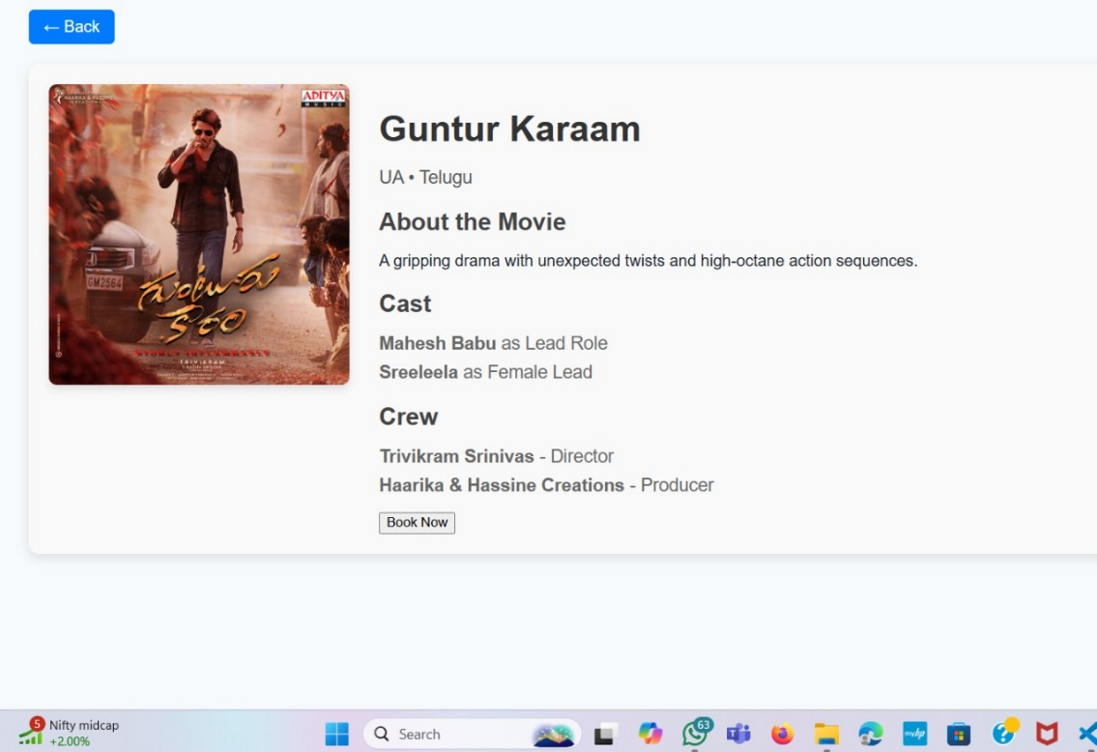
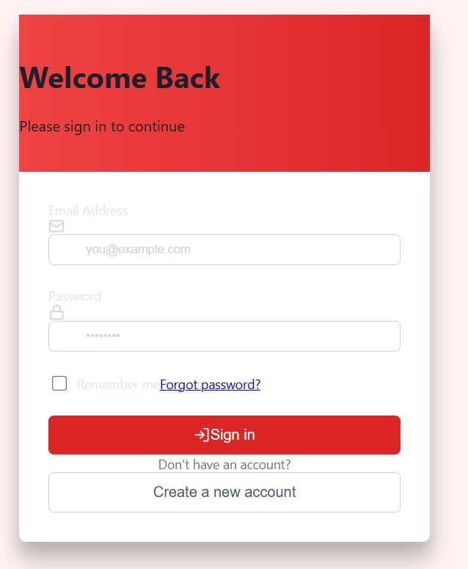
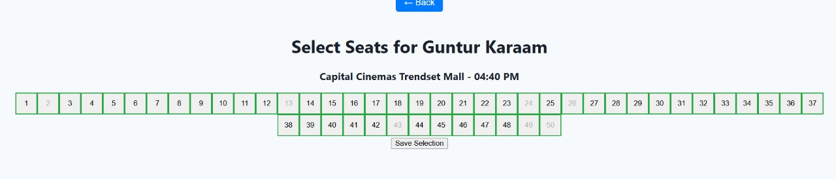
Documentation

Slide 9
Testing & Validation
Unit testing of backend services
Functional flow tests: booking, payment, cancellation
Responsive UI testing across devices
Validation and error handling in API responses

Slide 10
Conclusion
The Movie Ticket Booking System successfully achieves its objective of providing a seamless, secure, and user-friendly platform for both moviegoers and theater administrators. By leveraging modern web technologies like React.js, TypeScript, and MongoDB, the system offers real-time seat selection, secure payment processing, and efficient backend management. It not only enhances the user experience but also streamlines theater operations through its scalable and maintainable architecture. Overall, the project demonstrates a practical and innovative solution for modernizing the traditional ticket booking process.

Slide 11
Thank You
FINISH

